Slide 1



Engineering Drawing: ME101
Dr. Pankaj Kumar
Department Of Mechanical Engineering
National Institute of Technology Goa

Slide 2

Why Engineering Drawing in First year?

Slide 3

What is Engineering Drawing?

Slide 4


How we will do this Engineering Drawing?

Slide 5
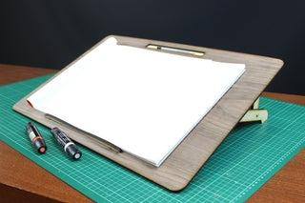
Unit 1:Introduction to Engg. Tools

Slide 6
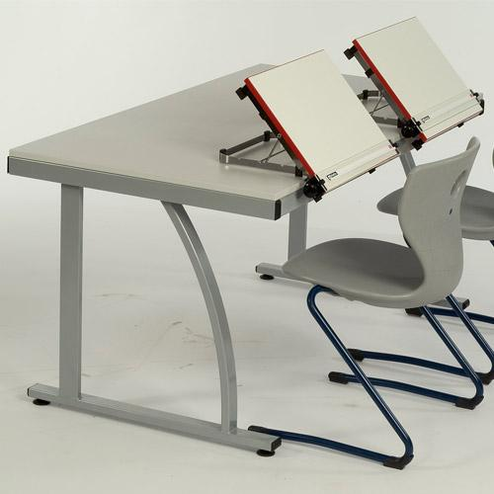
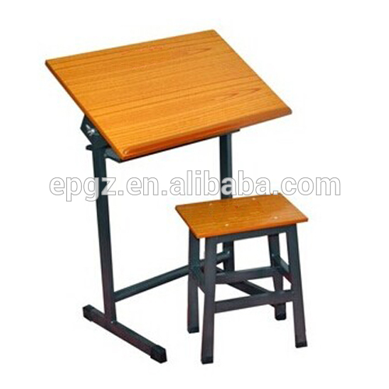
Introduction to Engg. Tools

Slide 7
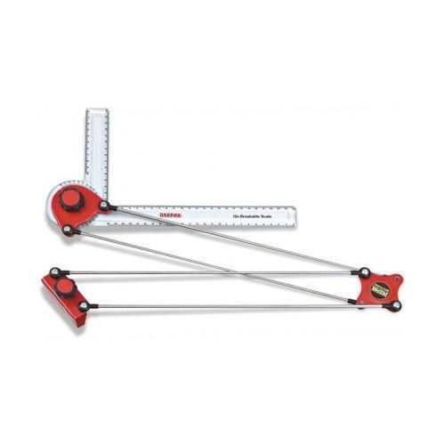
Mini Drafter

Slide 8
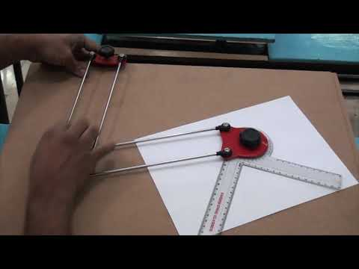
Unit 1:Introduction to Engg. Tools

Slide 9
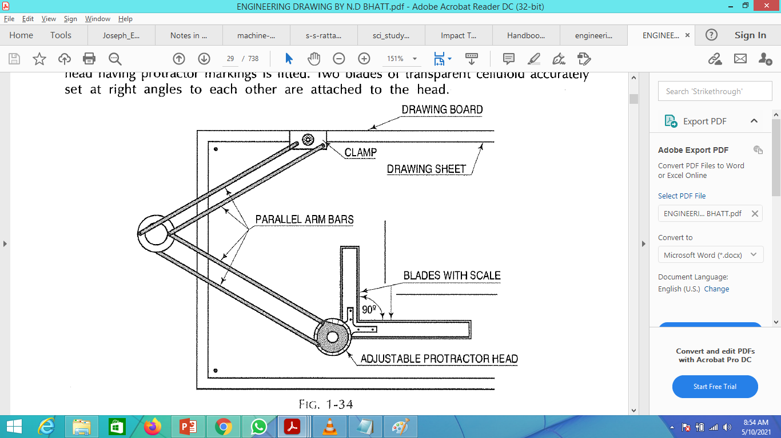
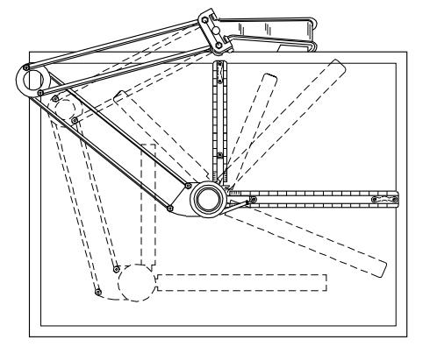
Unit 1:Introduction to Engg. Tools

Slide 10
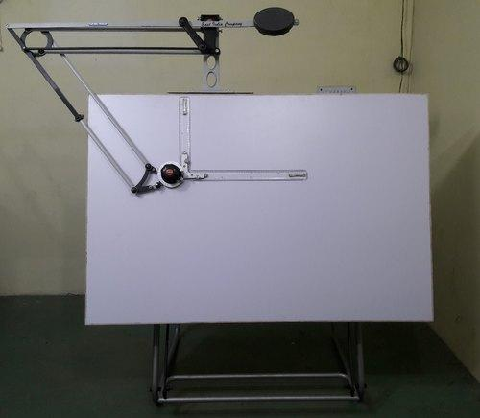
Drafter

Slide 11
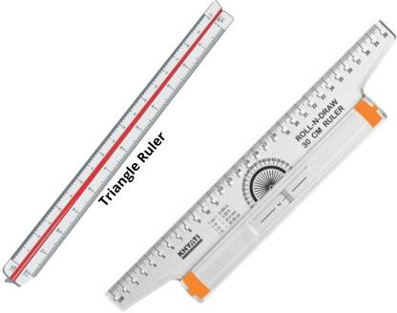
Roller Scale

Slide 12
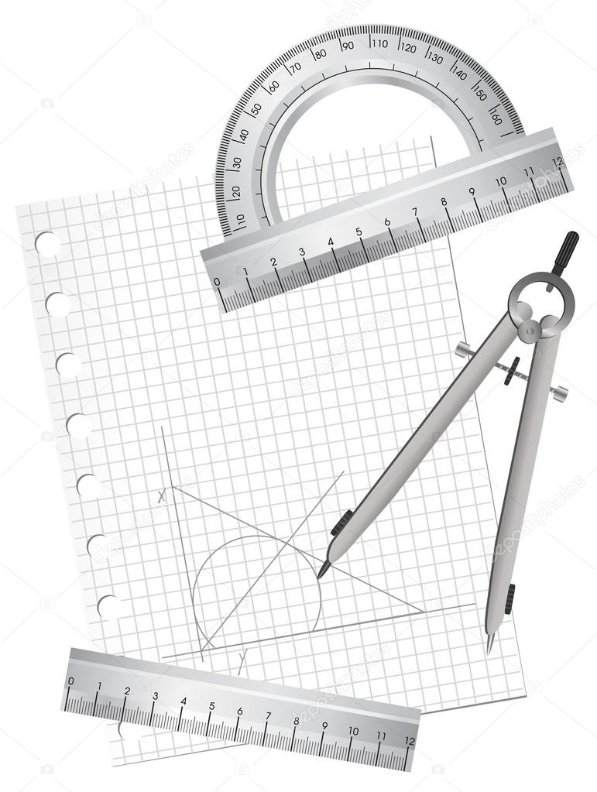
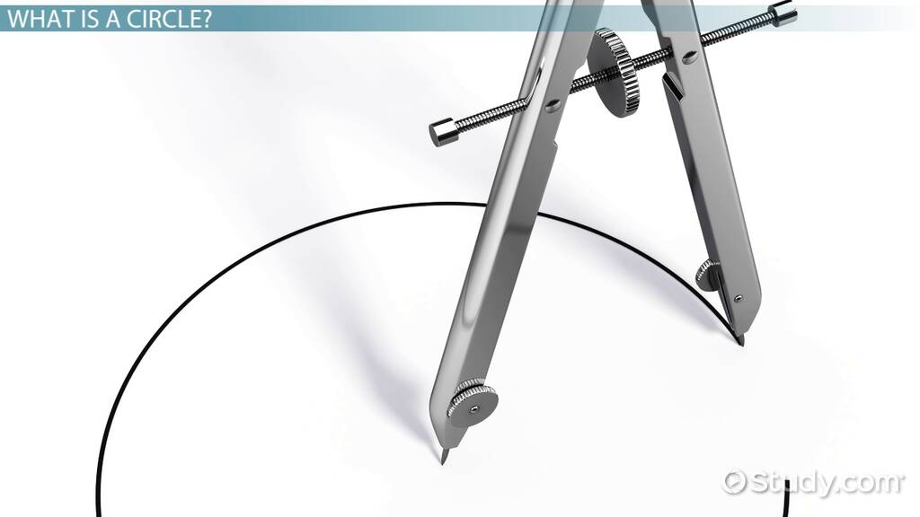
Compass

Slide 13
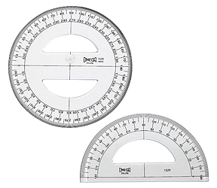
Protector

Slide 14
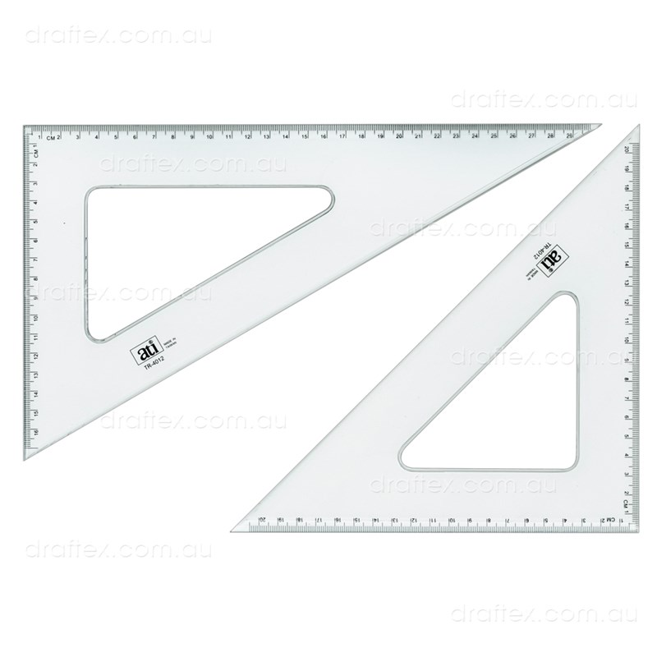
Set Squares

Slide 15
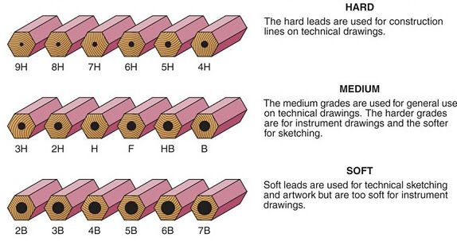
Types of Pencils

Slide 16
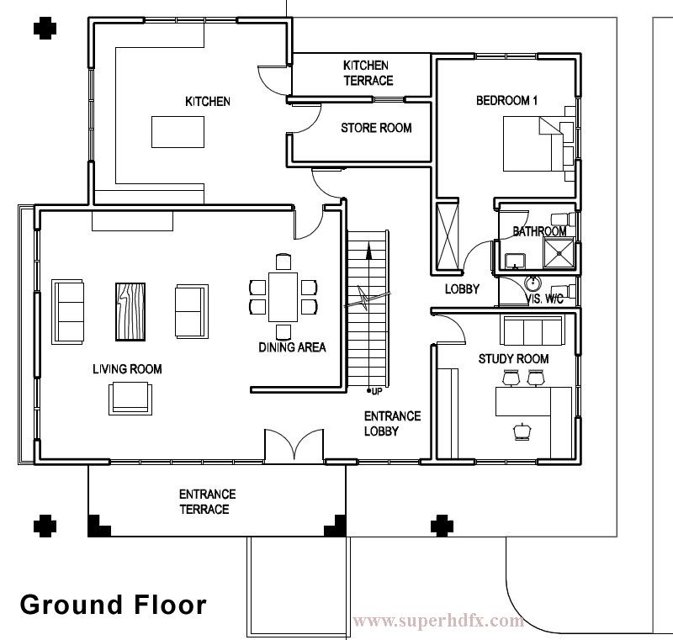
Drawing: CIVIL

Slide 17
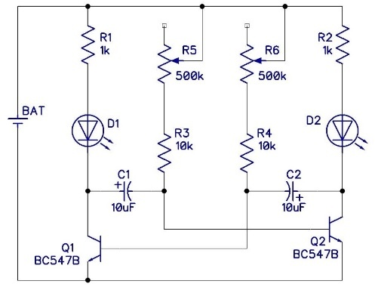
Drawing: ELECTRICAL

Slide 18
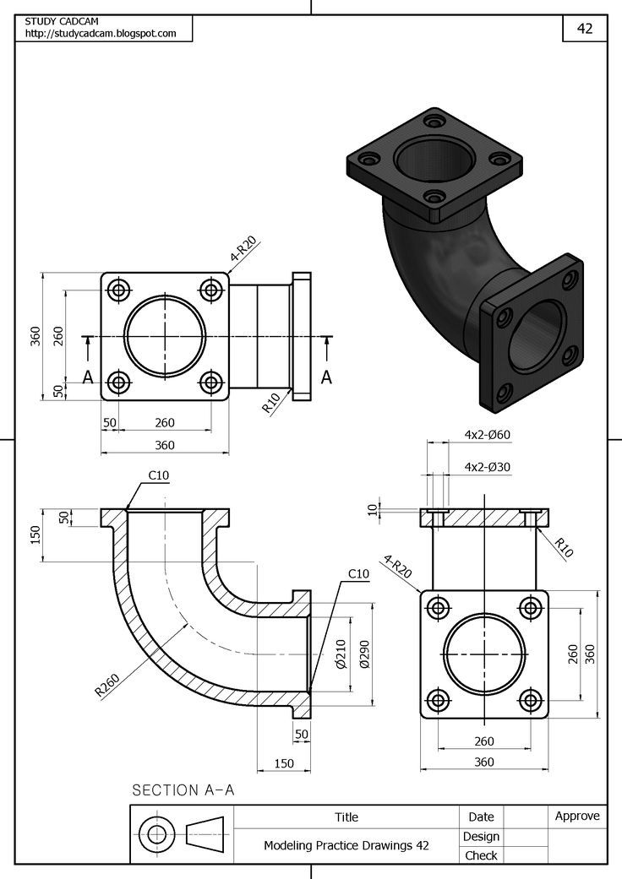
Drawing: MECHANICAL

Slide 19
Importance of Engg Drawing
Engineering drawings are often made professionally and expected to follow certain national and international standards, such as ISO standards.
People from different countries who speak different languages can share the common language of engineering drawing, and can thus communicate with each other quite well, at least as concerns the geometry of an object.

Slide 20





Types of Standards
ISO Standards-international standard (ISO)
ASME Standards-American Society of Mechanical Engineers
BS Standards-British Standards
DIN Standards-Deutsches Institut für Normung
JIS Standards-Japanese Standards Association

Slide 21
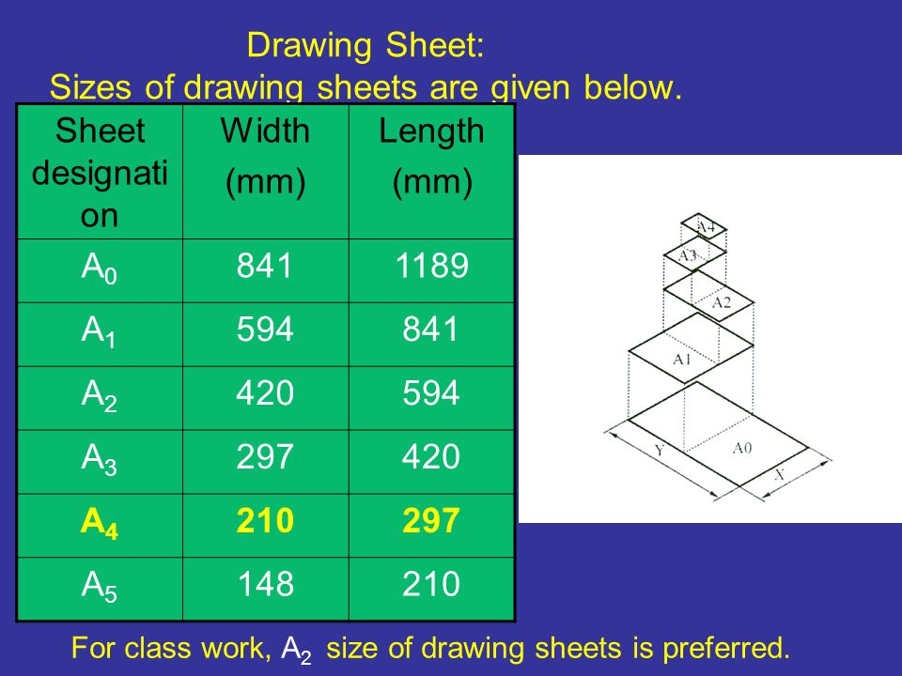
Dimensions of drawing sheet

Slide 22
Drawing Sheet
A₀
841 mm
1189 mm

Slide 23
Drawing Sheet
A₁
594 mm
841 mm

Slide 24
Drawing Sheet
A₂
420 mm
594 mm

Slide 25
Drawing Sheet
A₃
297 mm
420 mm

Slide 26
Drawing Sheet
A₄
210 mm
297 mm

Slide 27
Drawing Sheet
A₅
148 mm
210 mm

Slide 28
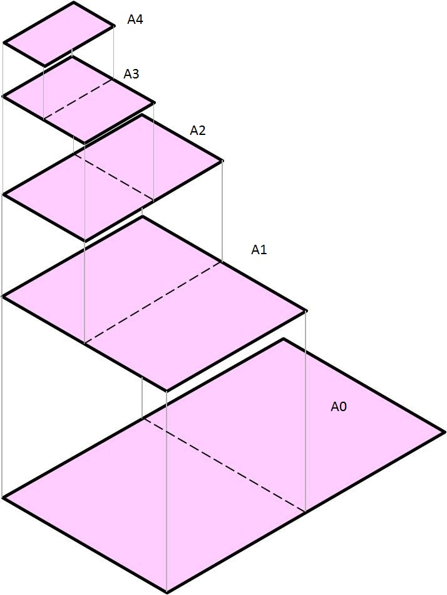
Types of drawing sheets

Slide 29
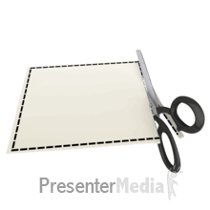
Error during cutting

Slide 30
Drawing Sheet
10 mm
A₄
210 mm
10 mm
297 mm

Slide 31
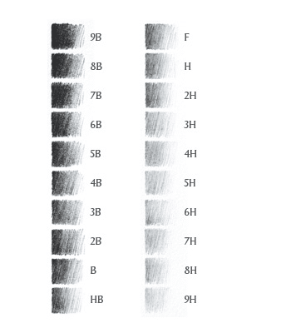
Types of pencils
Graphite Pencils
Graphite pencils are made from a mix of graphite and clay.
Blend of graphite and clay is responsible for variation in hardness.
More graphite - softer and blacker marks.
More clay - harder and lighter marks.
The "B" gradings-
Soft and black side
"H" gradings
hard and light side.
"F" is in-between.
"HB" is your standard writing pencil

Slide 32
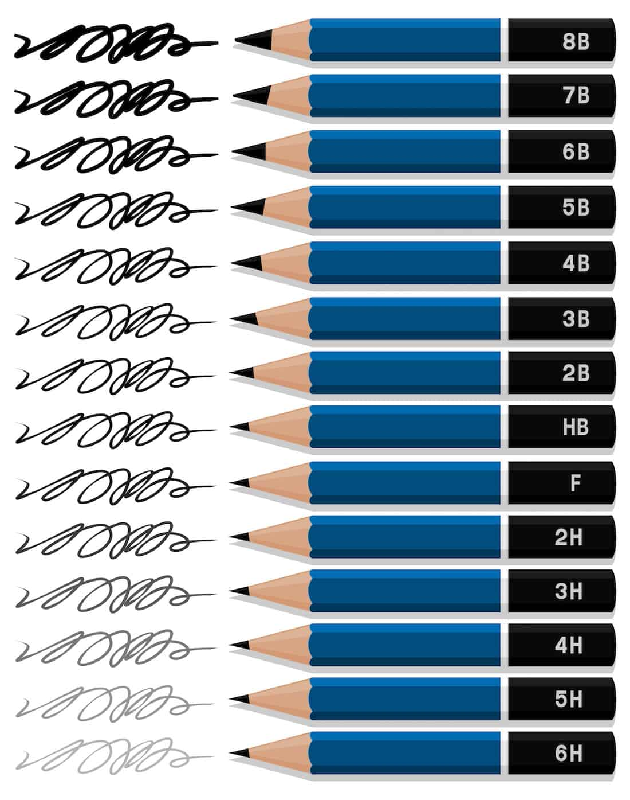
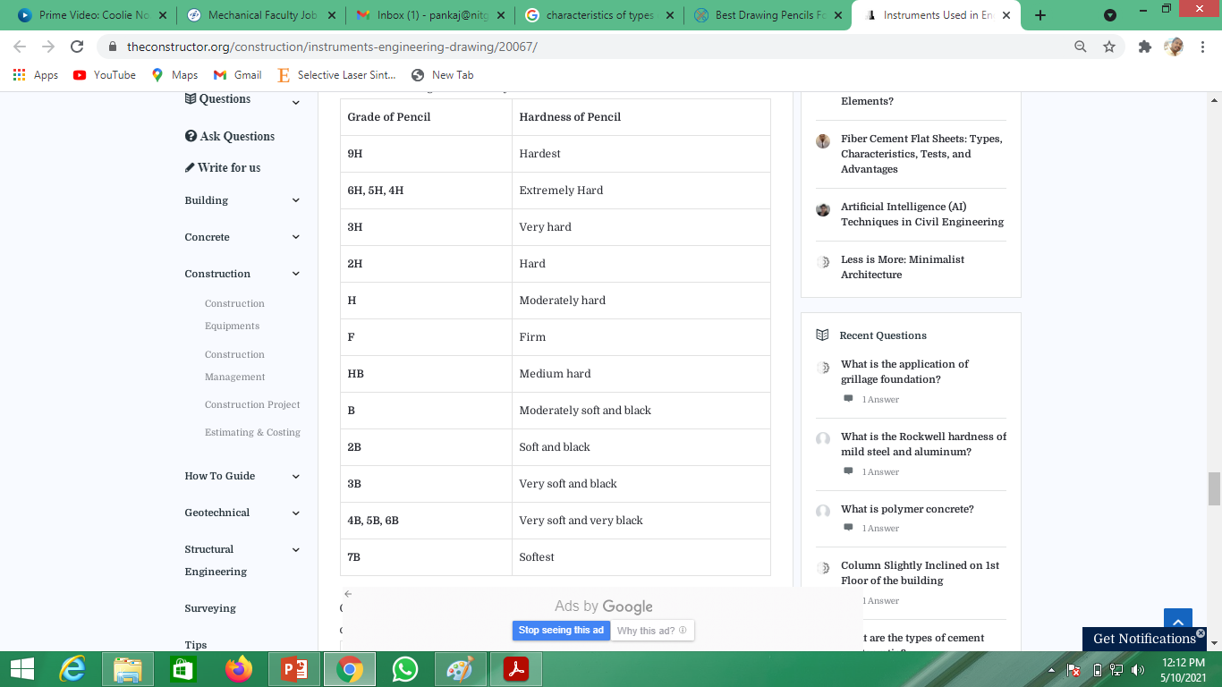
Pencils

Slide 33
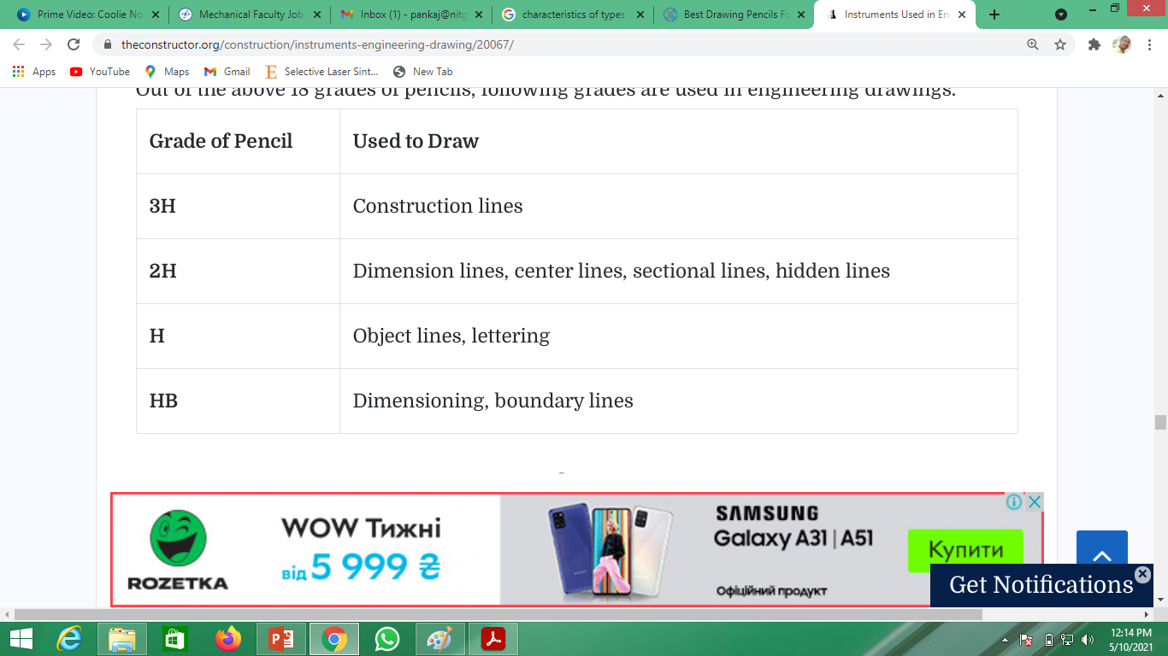
Primarily used pencils

Slide 34
Practice Session: Lettering
How to write?
This is single stroke writing...Always mind it….
Free hand and speedy
Minimizing the use of eraser

Slide 35
Practice Session: Lettering
How to write?
Neat and clean writing
Avoid overwriting
Use all space of the sheet

Slide 36
Practice Session: Lettering
Two ways:-
Vertical writing
Inclined writing (slope being 75° with the horizontal)
Method:-
Lettering style A
Lettering style B

Slide 37
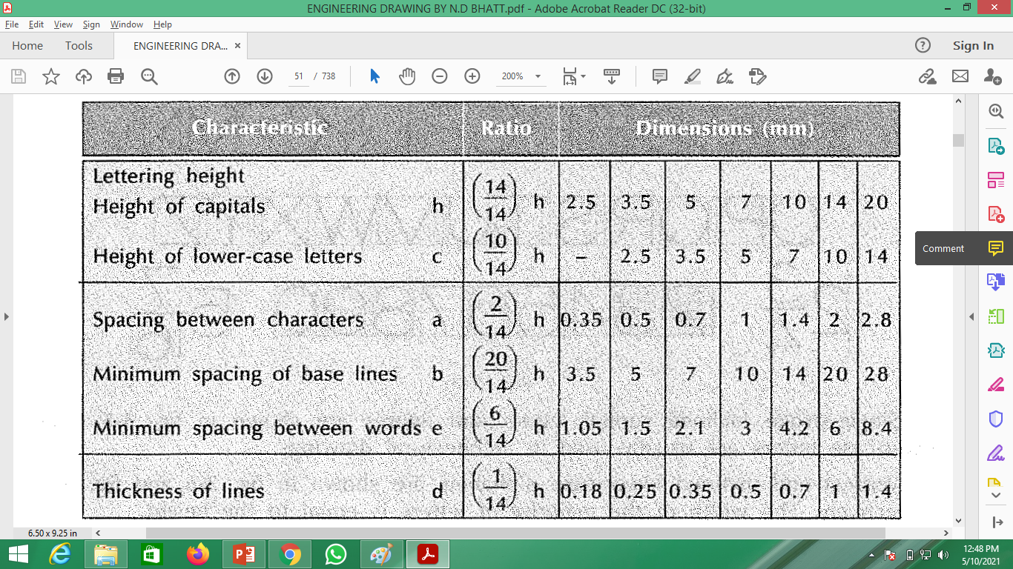
Lettering style A (d=h/10)
Preferably height to width ratio: 6:5

Slide 38
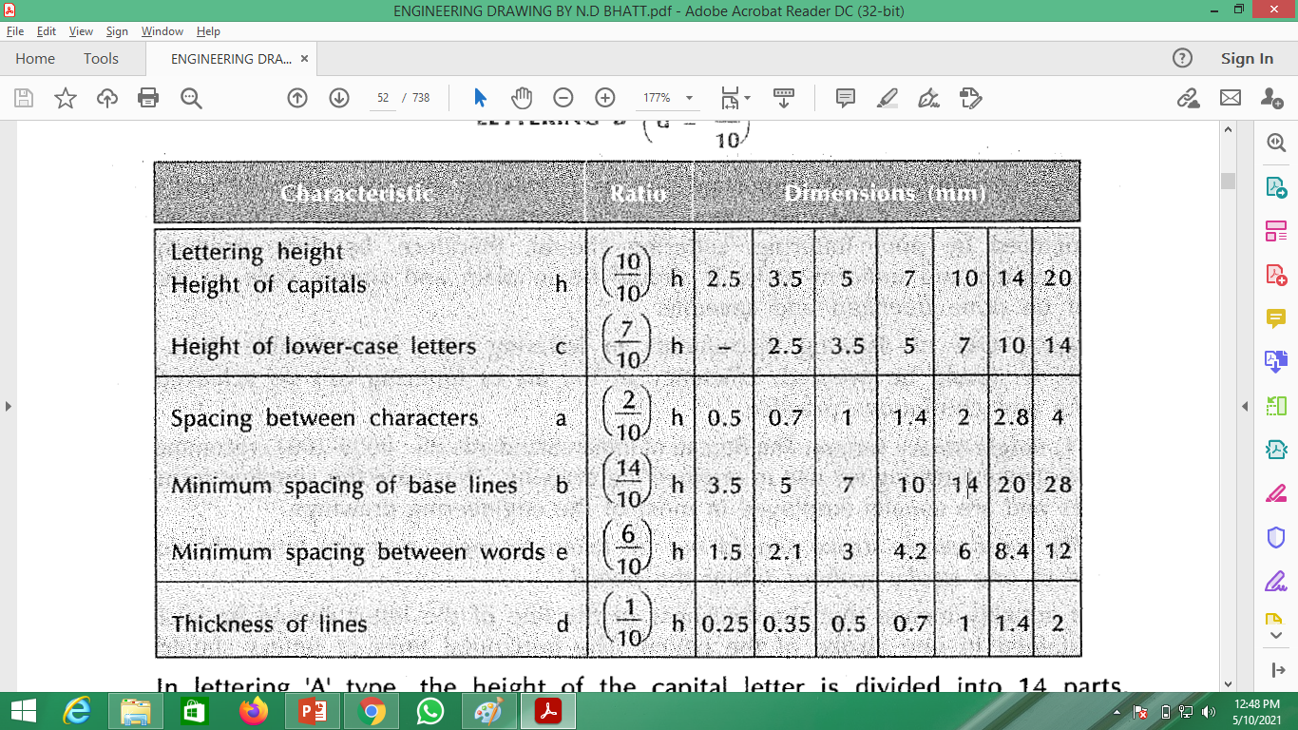
Lettering style B (d=h/14)
Preferably height to width ratio: 6:5

Slide 39
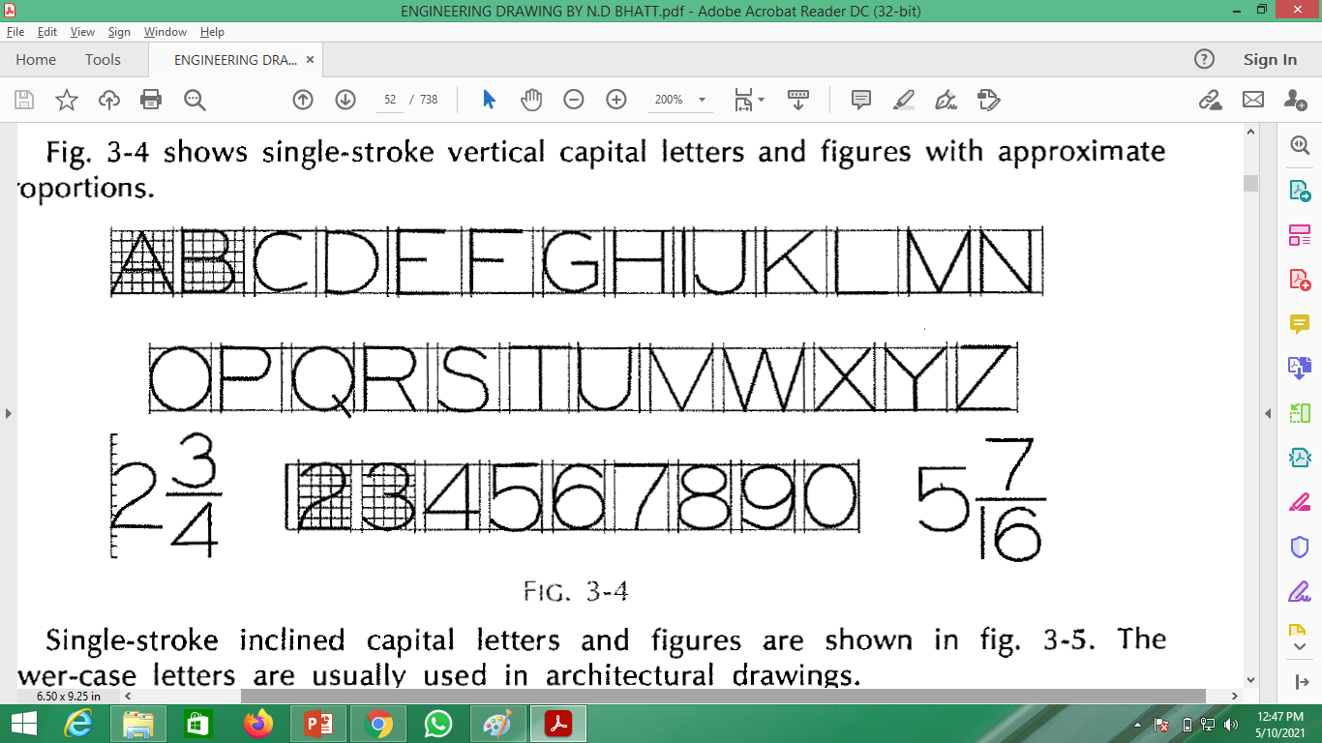
Practise: Uppercase letters

Slide 40
Drawing Sheet
10 mm
A₄
Engineering Drawing
210 mm
10 mm
297 mm

Slide 41
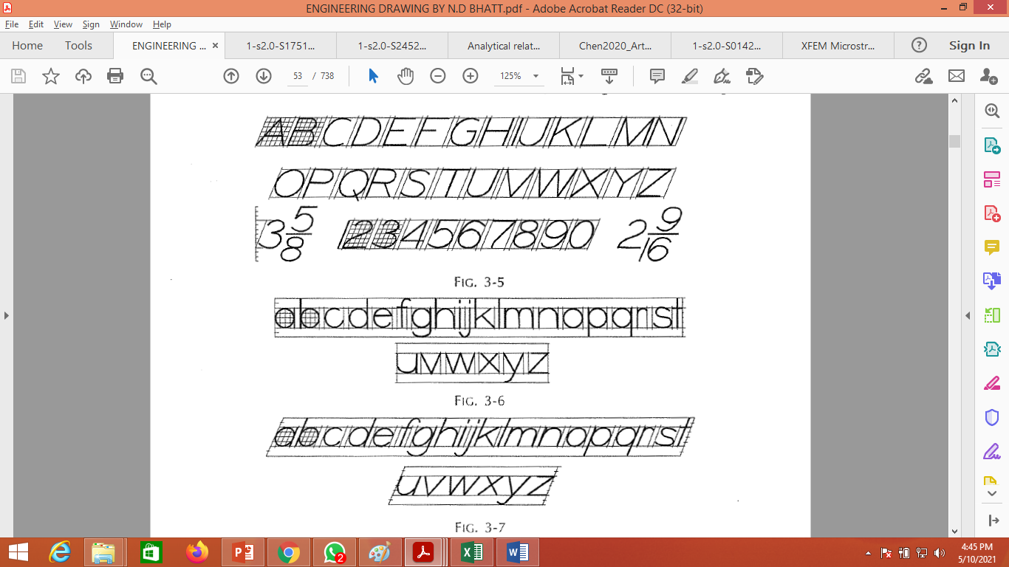
Lettering

Slide 42
How to write letters?
A
B
7
A
1
B
6
10
Characteristics | Lettering Scheme A
h | 7
w | 6
a | 1
b | 10

Slide 43
How to write letters?
p
b
5
5
1
Characteristics | Lettering Scheme A
h | 5
w | 5
a | 1
b | 10

Slide 44
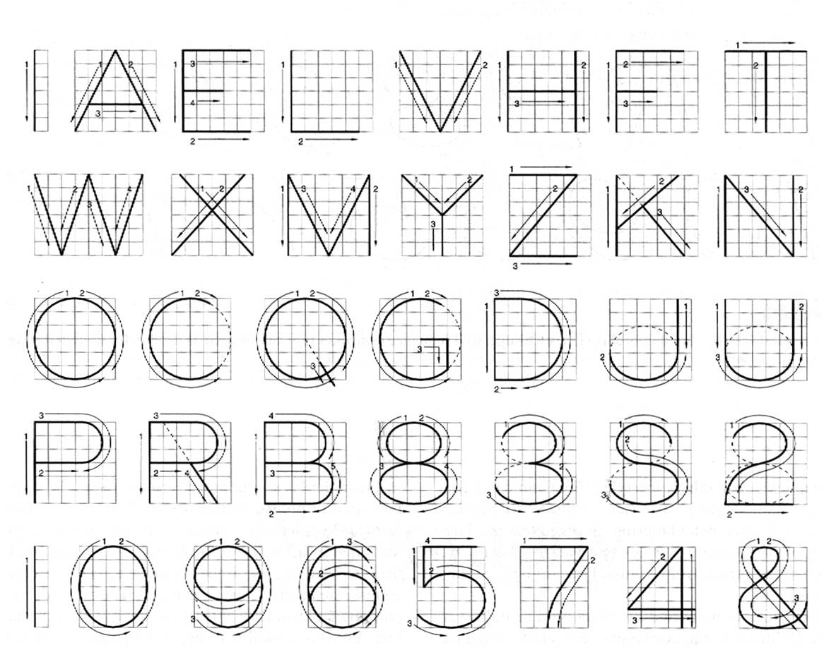
Capital letters

Slide 45
Numbers

Slide 46
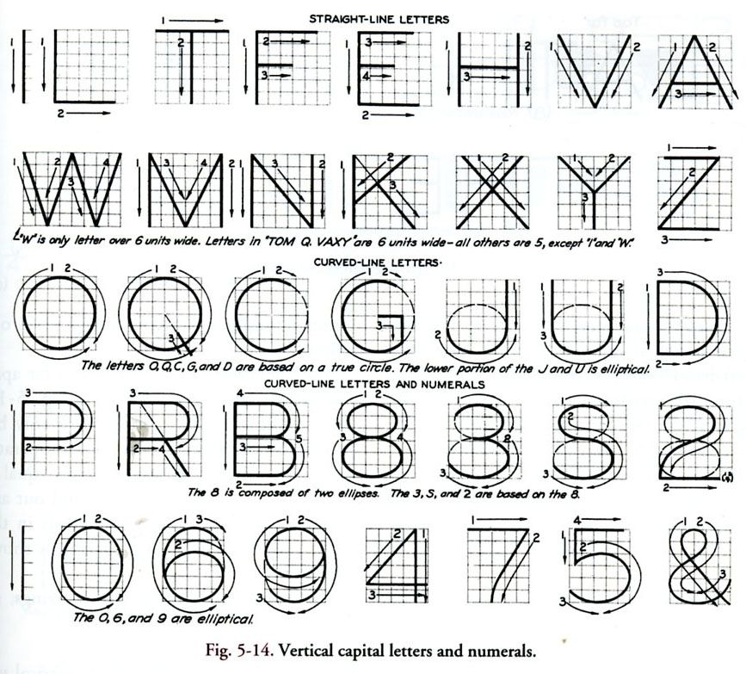
Capital Letters: How to write?

Slide 47
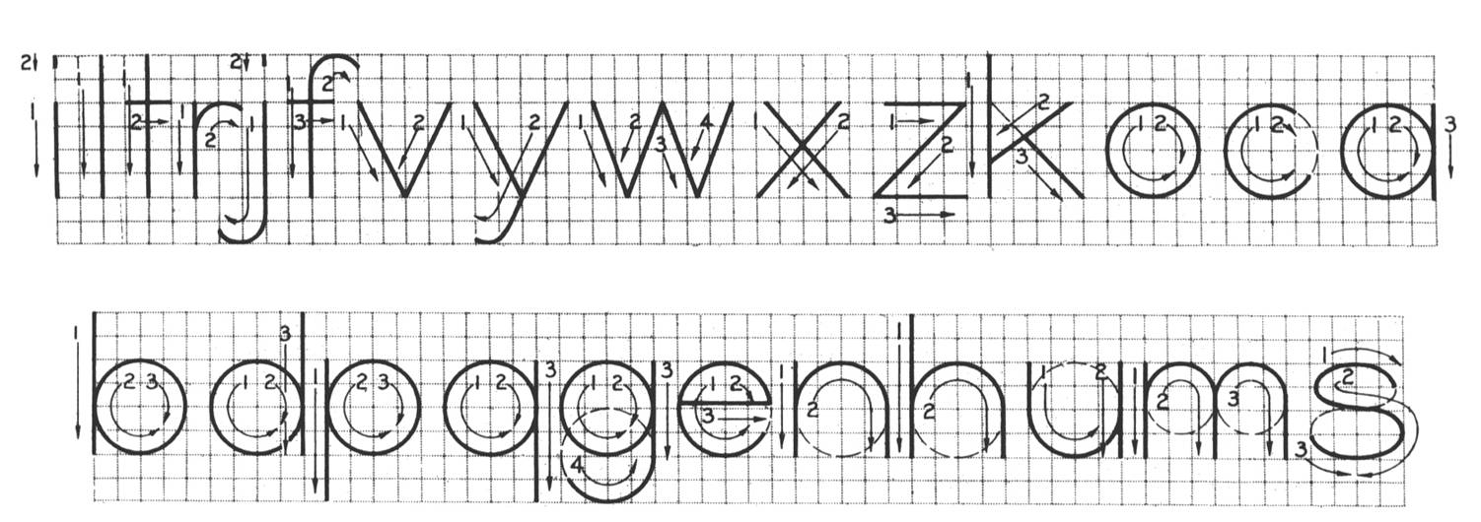
Small Letters: How to write?

Slide 48
Gothic Letters
The thickness of the stem may vary from 1/5 to 1/10 of the height of the letters.

Slide 49
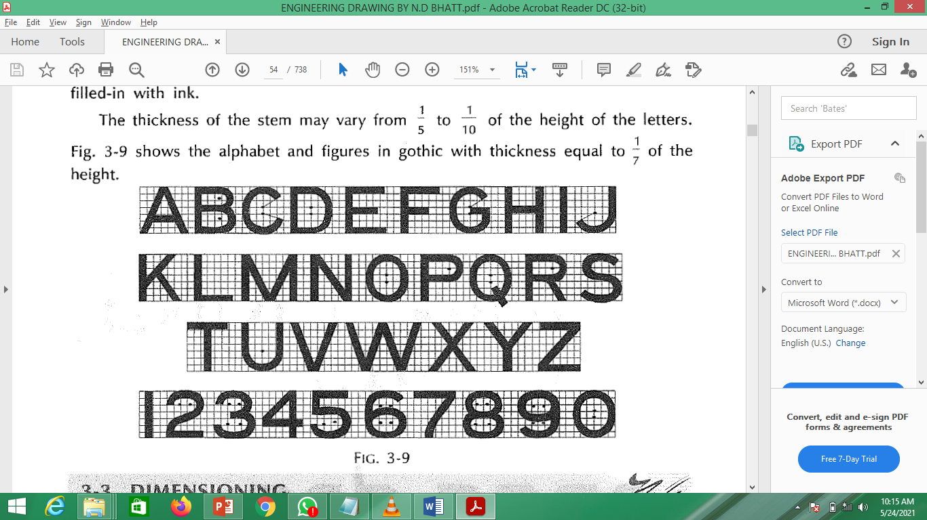
Gothic letters

Slide 50
Title Block
10 mm
A₄
210 mm
10 mm
297 mm

Slide 51
Title Block
185 mm
Title Block
65 mm

Slide 52
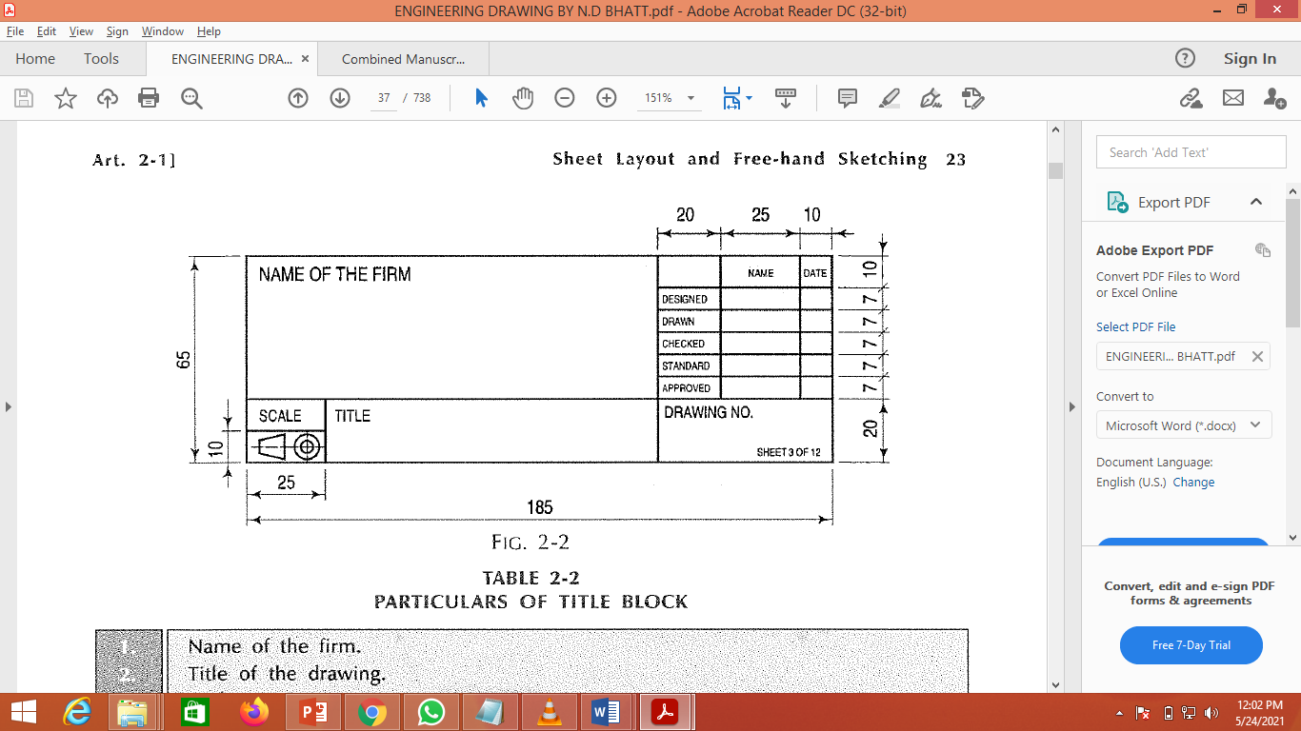
Reference Title Block

Slide 53
Title Block for A4 Drawing Sheet
120 mm
Title Block
60 mm

Slide 54
Title Block: How to draw?
120 mm
70 mm
10 mm
40 mm
60 mm
10 mm
45 mm
20 mm
25 mm

Slide 55
Unit 1:Introduction to Engg. Tools
70 mm
Your Name
Roll Number
40 mm
Institute Name
Branch
Date
Scale
Submission Date
Title of work
20 mm
Projections
Sheet Number
My Sign/Remarks
25 mm

Slide 56
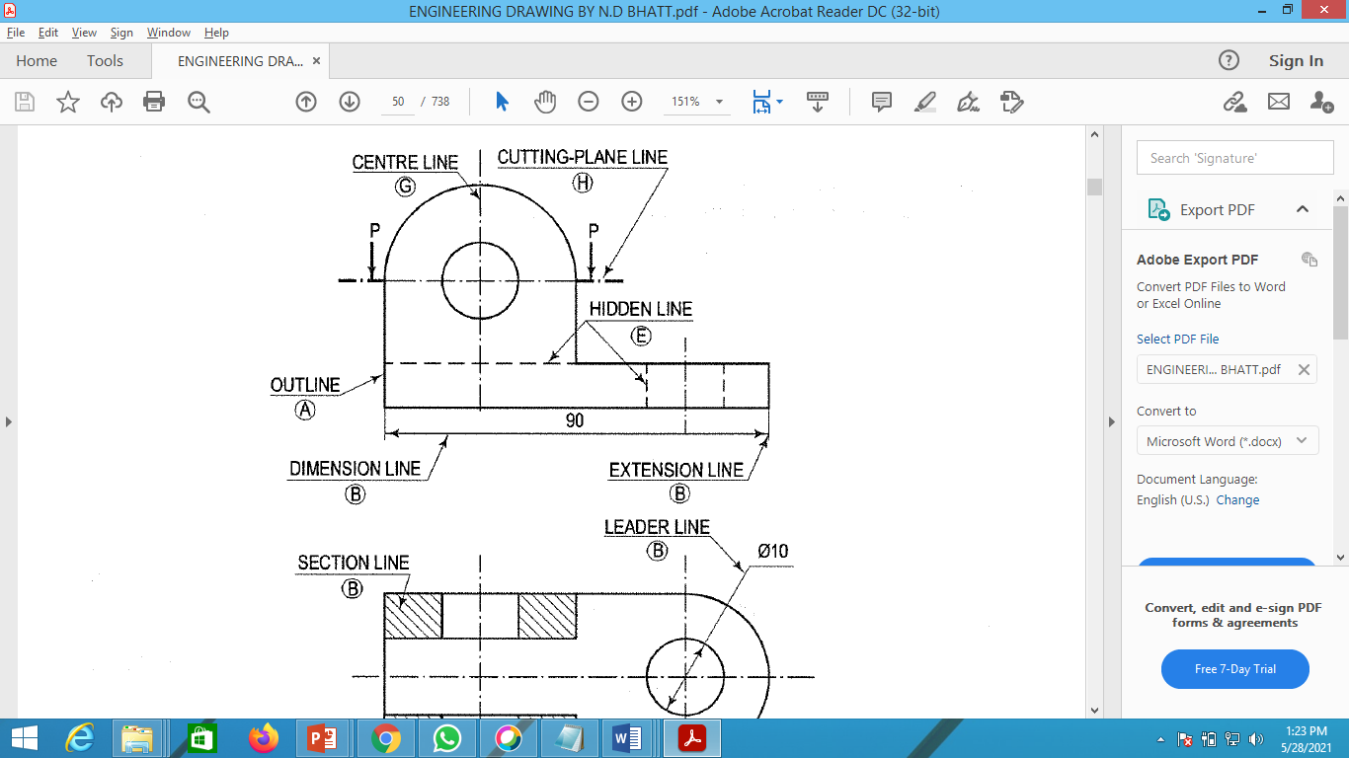
Lines: Important Figure 1

Slide 57
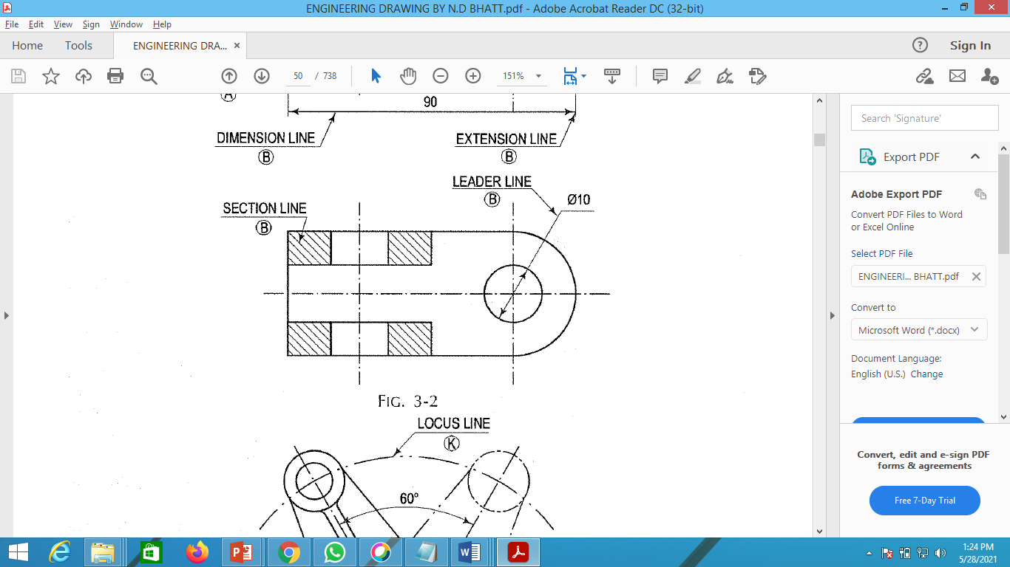
Lines: Important Figure 2

Slide 58
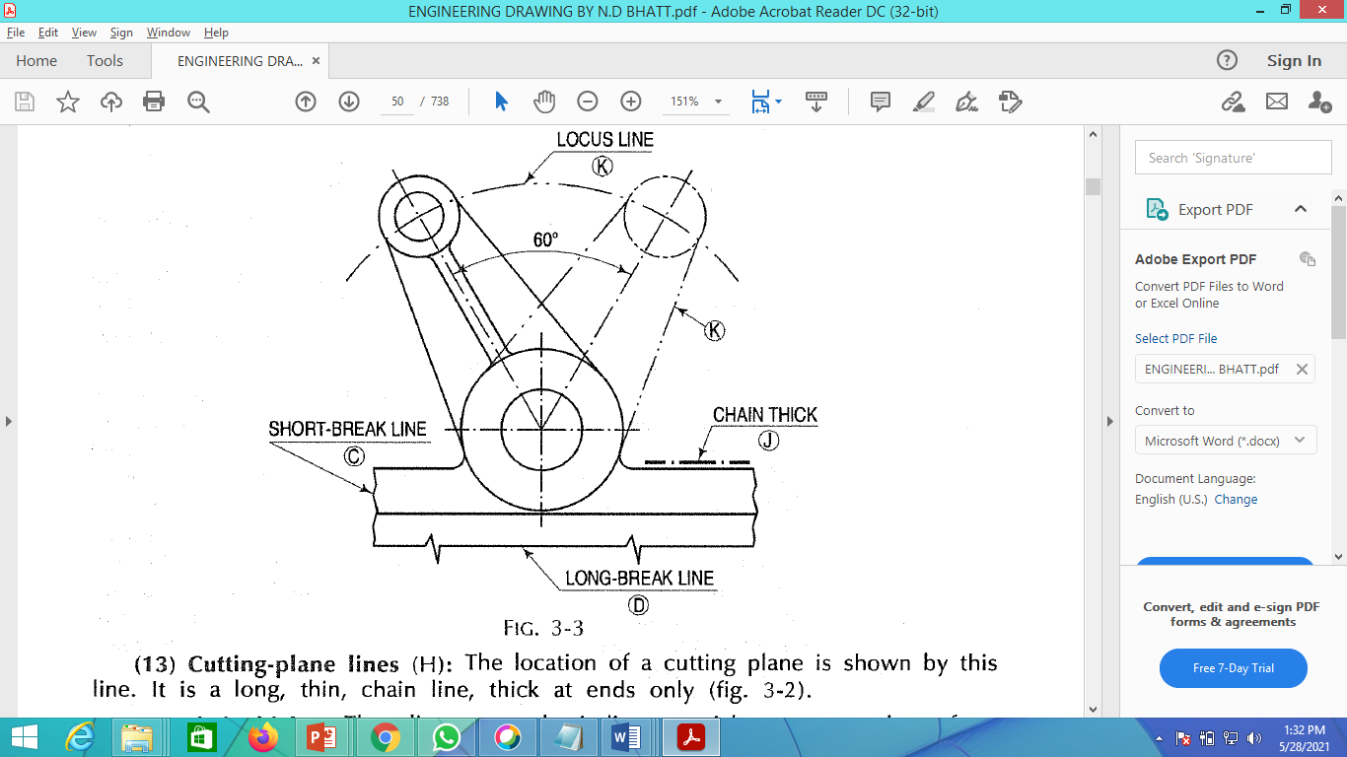
Lines: Important Figure 3

Slide 59
Unit 1:Introduction to Engg. Tools

